Slide 1
H&M Personalized Fashion Recommendations
Exploratory Data Analysis
Group 29
Ran Pan rp3016
Tao Wang tw2724
Zhining Qiu zq2199
Zhenyu Yuan zy2492
Smaranjit Ghose sg4018

Slide 2
Dataset Overview
The project contains three datasets: articles, customers, and transactions, which represent the transactions of customers and the metadata of customers and products. To conduct model analysis and training, we would join the three datasets by article_id and customer_id to obtain a metadata table
That dataset contains detailed features for each articles.
Articles
It has 25 columns with article_id as primary key. Main features are articles color themes, perceived color theme, article department and index in store.
That dataset contains customers geographical and active features.
Customers
It has 7 columns with customer_id as primary key. Columns like fashion_news_frequency represents the active status the customer would like to receive new series updates.
Transactions
The dataset contains the information regarding the purchase history of customers across time.
It has 5 columns: t_dat (date of the transaction), customer_id, article_id, price, sales_channel_id

Slide 3
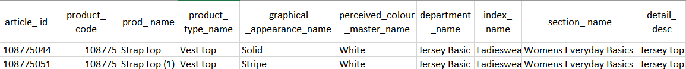
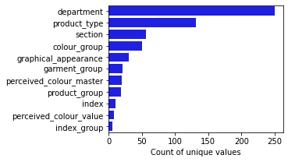
Summary
This table contains attributes (color, type, etc.) and description texts for each article
Ignorable missing data problem
Some attributes are hierarchical indices
index_group_name, index_name, section_name, and department_name
product_group_name and product_type_name
Each product_code corresponds to several article_ids, representing different colors, sizes, etc. (like the clothes rack below).
01
Articles
Sample of the table

Slide 4
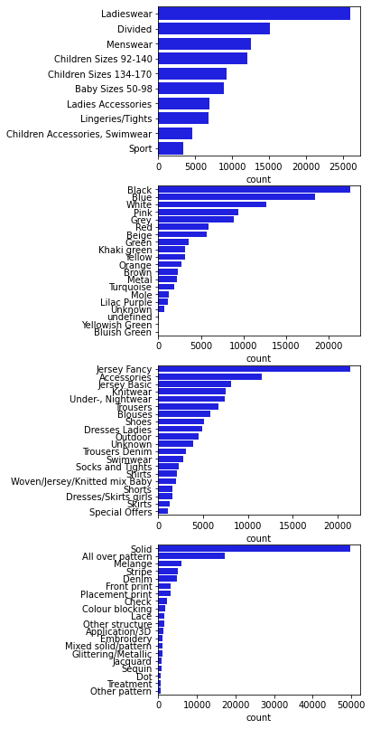
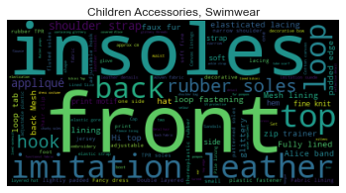
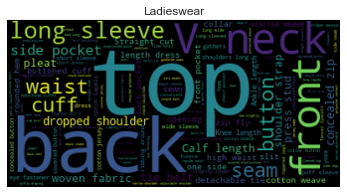
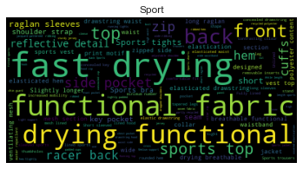
The articles table
Distribution of some attributes
Common words in description text (by category (index_name), excerpt)
Some attributes have high cardinality, but a few top values would contain most rows. Cutting off at top n values may help with data sparsity.
Description texts varies a lot across different categories of products, which suggests the texts contain more information about the product. Including this column seems promising, but this could worsen the sparsity issue.

Slide 5
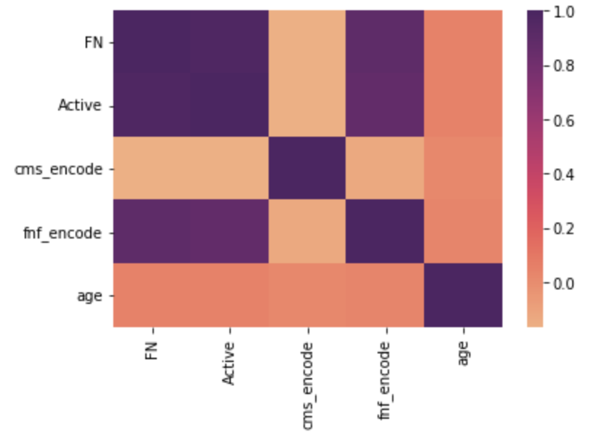
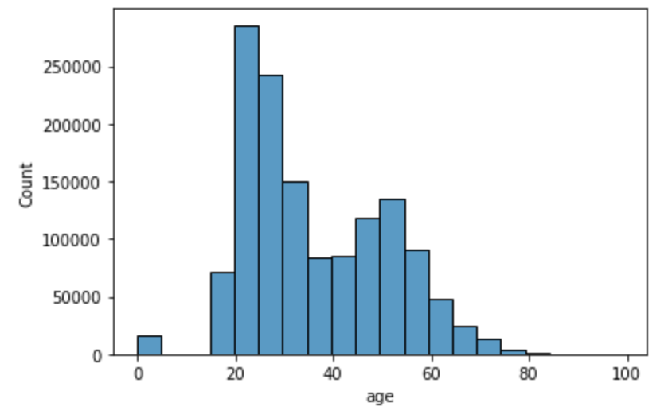
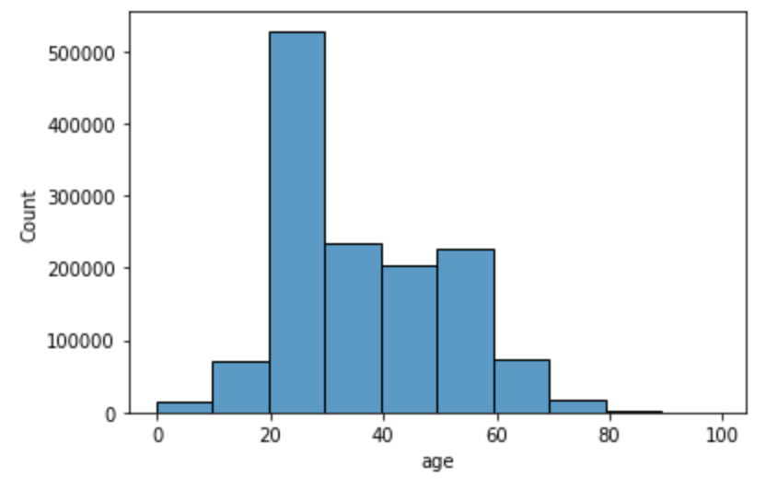
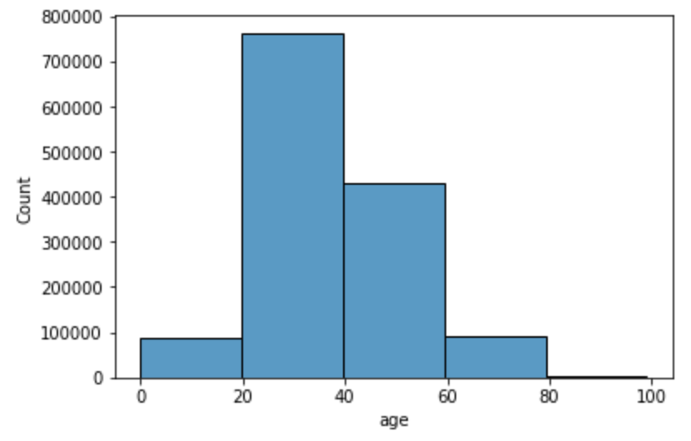
02 Customers
Through Data exploration process, those three columns are high correlated:
FN
Active
Fashion_news_frequency
From the correlation heatmap, we could see that the Active
and the FN columns are nearly identical.
We only keep the fashion-news_frequency and use one-hot
encoding for later training.
Another feature is age that might help our models to classify
which type of articles customer would like to purchase.
Ages have those distribution by setting different binwidth that we could use for grid search.
Binwidth = 5 Binwidth = 10 Binwidth = 20

Slide 6
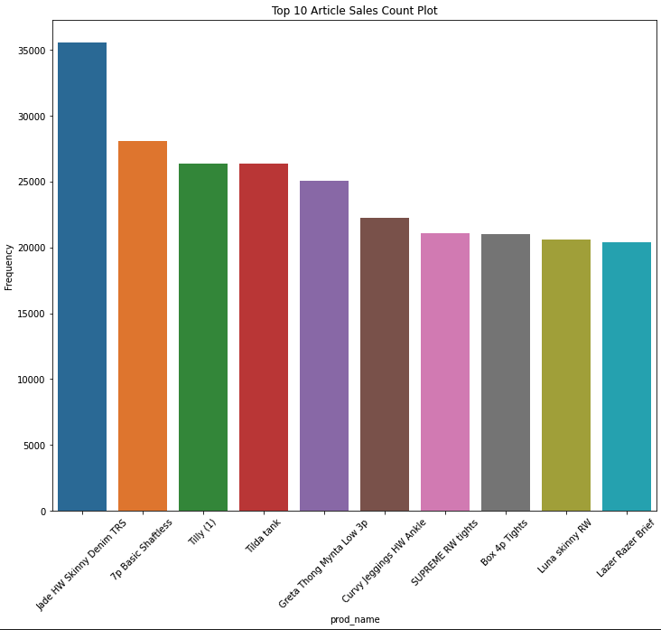
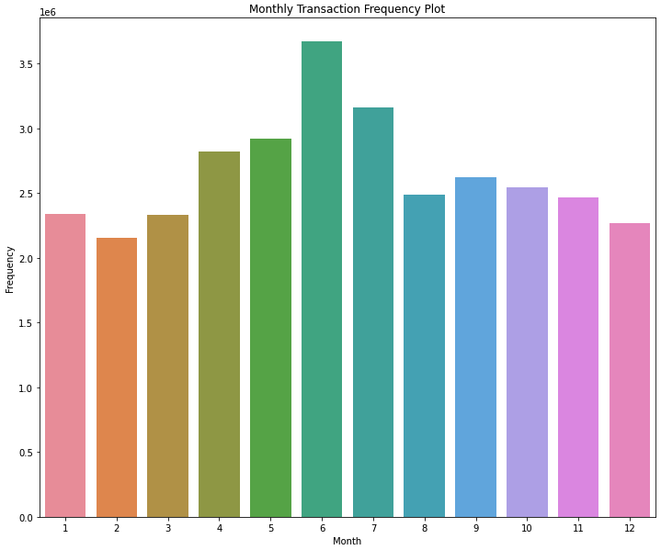
03 Transactions
Summary
This dataset contains information regarding every transaction of HM clothing
The dataset has 5 columns: t_dat (date of the transaction), customer_id, article_id, price, sales_channel_id
The dataset has no missing values
From the monthly transaction frequency plot, we can see that HM customers made the most purchase in June, and they made least number of purchases in February.

Slide 7
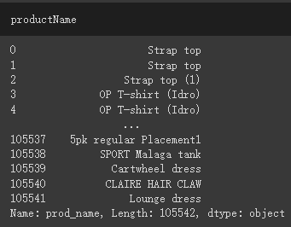
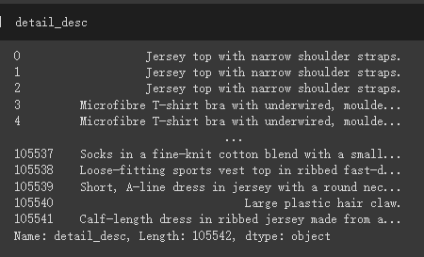
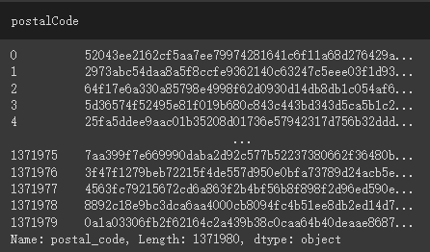
Data Preprocessing
Drop column
Article
The prod_name and detail_desc columns in article table record the product’s name and its brief description.
We are dropping these two for our baseline model, and will try to integrate them later and see if it will increase performance.
Custom
The postal_coded column in customer table records customers’ postal code. However, it is encrypted and we can’t get information from it.

Slide 8
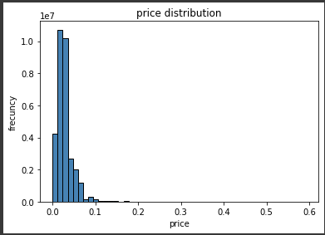
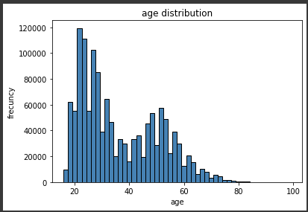
Data Preprocessing
2. Scaling
Price
Most transactions’ price are between 0 and 0.1. However the highest price is 0.6.
Age
Most customers are between the ages of 20 and 60. We scale it to get a similar range to other features.
3. Categorical Data
Categorical features in our dataset, such as group type and department name, are not ordinal. We handle them using One-hot encoding.

Slide 9
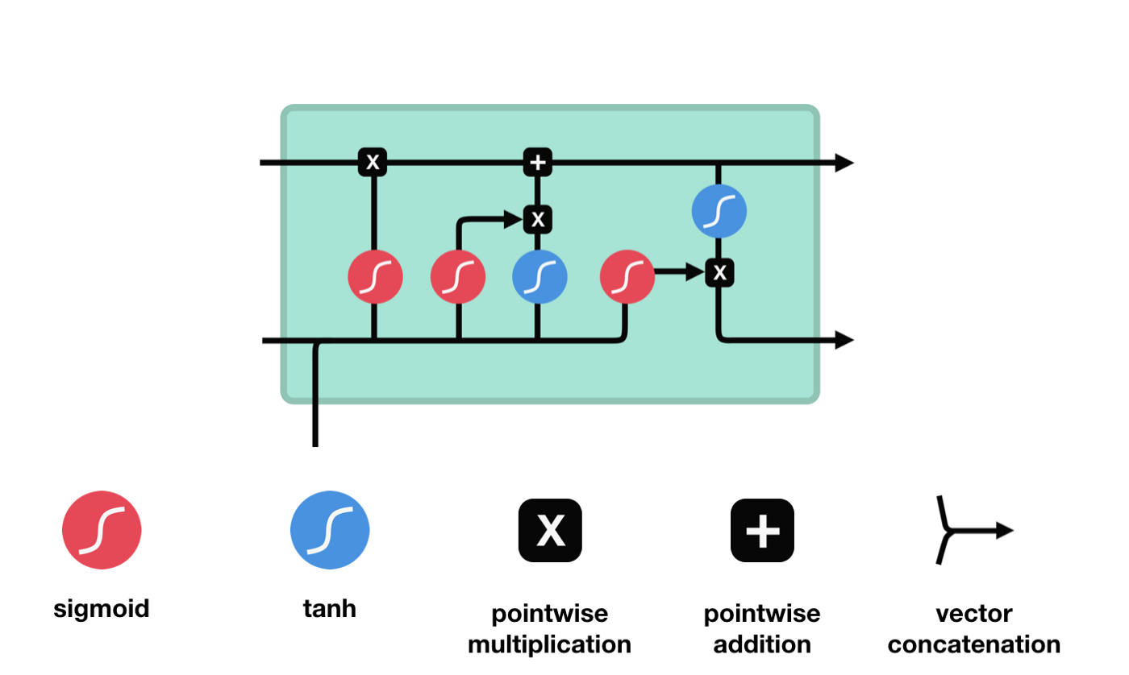
Machine Learning Techniques
Methodology Overview
Convert various features of a product into a fixed length feature embedding
Fit an autoregressive model on each customer's purchase activities
For prediction, feed the trained autoregressive model with a customer's history, and take it's output as our prediction
The method is analogous to Seq-to-Seq methods in NLP
Product Embedding
Map each value of categorical features into an n-dimensional vector, and concat the columns together
Apply certain NLP model (variants of BERT) to obtain a representation for the names of the products and the product descriptions
All the above vectors will be concatenated into a long vector embedding for each product, and all the embedding layers will be trainable
Autoregressor
Train an autoregressor (LSTM) on each user's purchase history. The input to this model would be the embedding obtained above and the training process would be analogous to the language model task in NLP.

Slide 10
THANK YOU

